Slide 1
Gym Management
Mentor name: Prof. Shakila Shaikh
Presentation By :
Samkit Sanghvi(N019),
Vansh Israni(N025)

Slide 2
Presentation Agenda
Introduction
Project Overview
Project Workflow (EER)
Technologies Used
Schema Diagram
Query
Self Learning
Lessons Learned
Challenges Faced
References

Slide 3

Introduction
A well-organized Gym Management Database serves as a central hub, storing crucial information about the fitness center, including member details, subscription plans, and equipment inventory. This enables streamlined management of subscriptions, billing, and member communication, while also ensuring optimal maintenance of gym equipment. Additionally, the database facilitates easy access to class schedules and sign-ups, enhancing member experience and enabling data-driven decision-making. Our project aims to leverage this technology to enhance gym operations, ultimately improving the overall experience for both members and staff.

Slide 4
Project Overview
Goal: Our project aims to revolutionize gym management by introducing a comprehensive Gym Management Database, streamlining operations, and enhancing the overall gym experience for both members and staff.
What it Does: The Gym Management Database serves as a centralized platform to store crucial information such as member details, subscription plans, equipment inventory, and class schedules. It facilitates efficient management of subscriptions, billing, member communication, equipment maintenance, and class scheduling.
For Staff: Staff members benefit from streamlined workflows enabled by the Gym Management Database. It simplifies tasks such as member registration, subscription management, billing, equipment maintenance scheduling, and class scheduling. This allows staff to focus more on delivering exceptional service and fostering a positive gym environment.

Slide 5
Project Overview
Using Tech: Our project leverages modern technology to create a user-friendly and efficient Gym Management Database. Features include web and mobile accessibility, automated processes for subscription management and billing, real-time equipment tracking, and easy-to-use interfaces for staff and members.
Big Picture: The implementation of the Gym Management Database represents a significant step towards transforming gym operations. By centralizing information and automating processes, we aim to improve efficiency, enhance member experience, and empower staff to deliver exceptional service. Ultimately, our project contributes to the growth and success of fitness centers by enabling data-driven decision-making and fostering a positive gym environment.

Slide 6
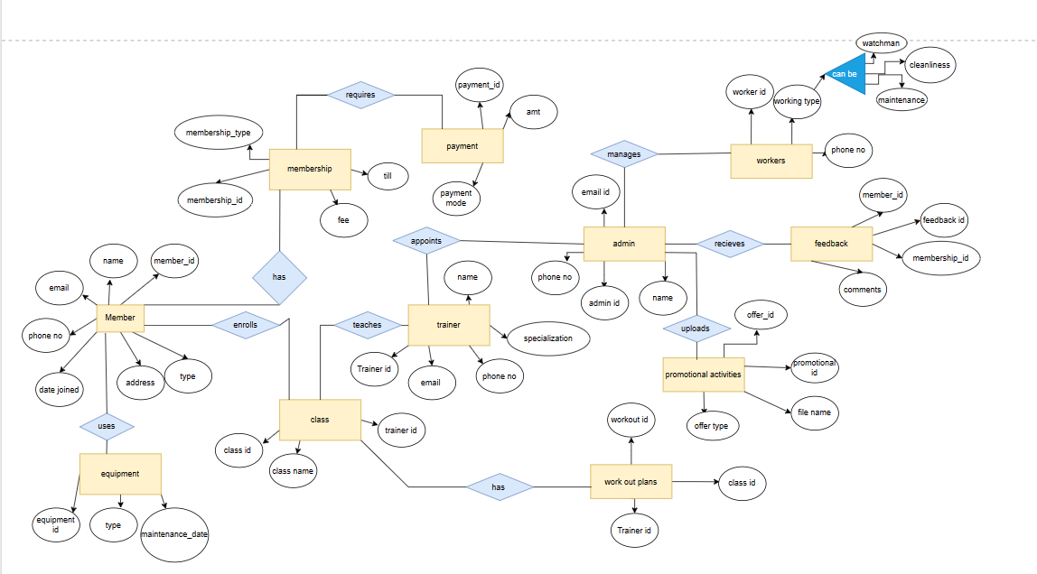
Project Workflow (EER)

Slide 7


Technologies Used
MySQL Workbench
Draw.io

Slide 8
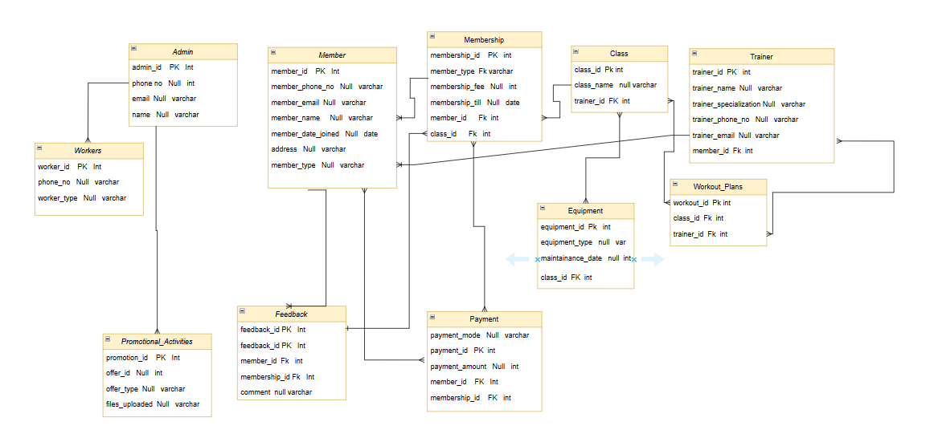
Schema Diagram

Slide 9
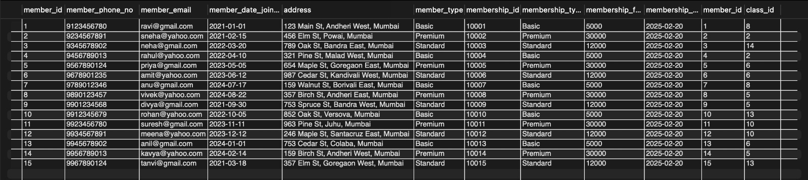
Queries
Here are some queries we implemented in the following project.
Retrieve all members along with their membership details
CODE:
SELECT Member., Membership. FROM Member JOIN Membership ON Member.member_id = Membership.member_id;
OUTPUT:

Slide 10

Queries
2) Find the membership types with the highest and lowest membership fees.
CODE:
SELECT MAX(membership_fee) AS highest_fee, MIN(membership_fee) AS lowest_fee FROM Membership;
OUTPUT:

Slide 11
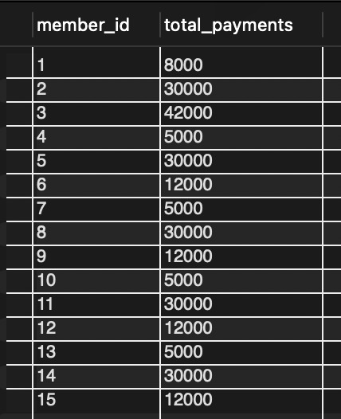
Queries
3) Find the total amount of payments made by each member.
CODE:
SELECT member_id, SUM(payment_amount) AS total_payments FROM Payment GROUP BY member_id;
OUTPUT:

Slide 12
Self Learning
1. Immersive Learning Experience:
- The project offered practical application of theoretical concepts in database design and SQL within gym management.
2. Table Creation and Entity Design:
- Creation of tables for members, trainers, classes, and equipment provided insight into database schema design and normalization techniques.
3. Understanding Gym Management:
- The project's focus on memberships, classes, and workout details deepened understanding of gym operations.
4. Importance of Keys:
- Establishing primary and foreign keys ensured organized database structure and maintained data integrity.
5. Enhanced Query Skills:
- Writing SQL queries for data manipulation tasks honed efficiency in searching and managing information.

Slide 13
Lessons Learned
1. Database Schema Design: Learned how to design a database schema, including entity relationships, normalization, and data integrity constraints.
2. SQL Proficiency: Increased knowledge of SQL syntax and its application in database management.
3. Error Handling and Data Validation: Implemented mechanisms for error handling and data validation to maintain data integrity and handle unexpected scenarios effectively.
4. Practical Experience: Gained insights into real-world challenges and considerations involved in developing and managing database systems through hands-on project work.
5. Project Management Skills: Developed project management skills such as requirement analysis, task prioritization, and effective communication through managing the Gym Management project.

Slide 14
Challenges Faced
Challenges in Gym Management Project with SQL:
1. Normalization:
- Ensuring data integrity through normalization while addressing dependencies and anomalies.
2. Error Handling:
- Robust mechanisms needed to manage constraint violations and syntax issues during operations, preserving data integrity.
3. Complex Queries:
- Writing and optimizing SQL queries for data retrieval, updates, and aggregation.
4. Entity Relationships:
- Establishing and managing relationships between members, classes, trainers, and equipment, including enforcing referential integrity constraints.

Slide 15
References
SQL TutorialW3Schoolshttps://www.w3schools.com › sql SQL TutorialGeeksforGeekshttps://www.geeksforgeeks.org › sql-tutorial

